Slide 1
DOT HRS – Detector Mount

Slide 2
Scope of this analysis
Estimate heat loads and temps on detector
Estimate XY movement of detector face from heat loads
Compare scenarios below
Estimate thermal transients from detector readout
Scenario | Ribs | Mount | Shield
1 | Yes | As-designed | As-designed
2 | No | As-designed | As-designed
3 | Yes | Ideal flexure mount | As-designed
4 | Yes | Ideal flexure mount | Extended forward

Slide 3
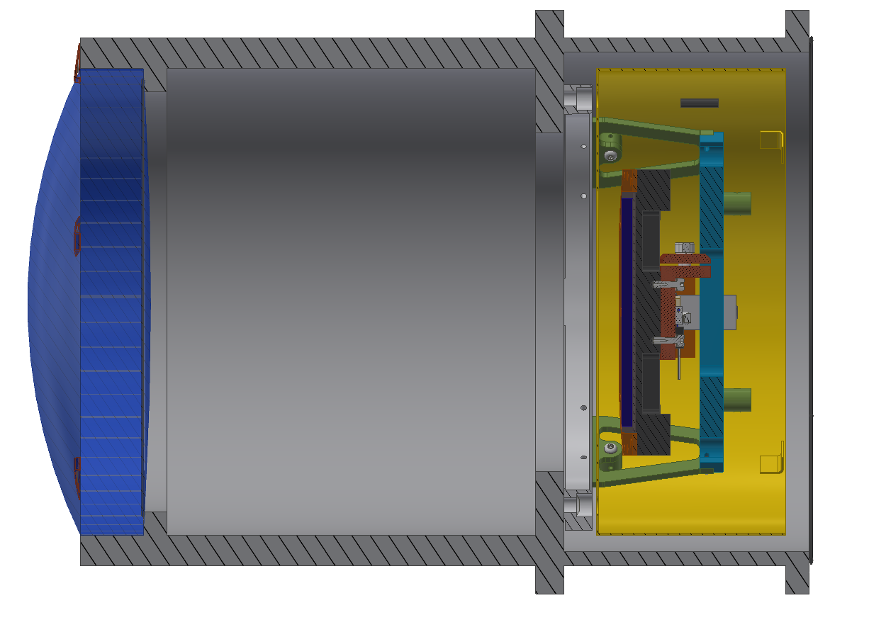
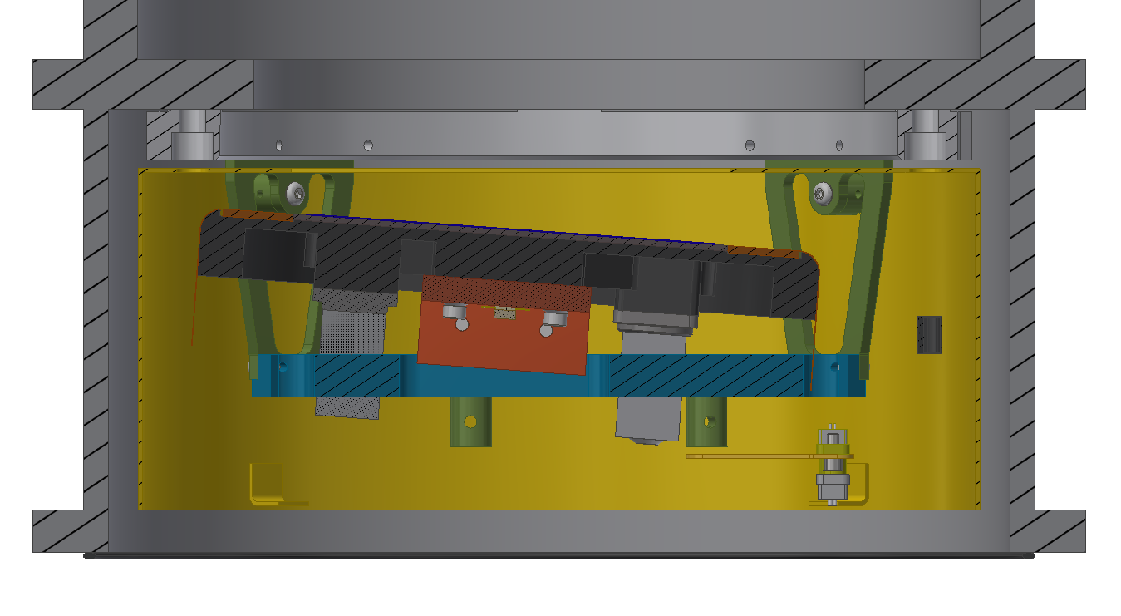
Mount Overview

Slide 4
Passive Shield

Slide 5
Heat loads
Analytically: modelled as cylindrical shell
2 Detector
(CF @ 160 K)
1 Window
Black Body
e = 1
T = 300K
F12 = 0.06
4 Cold Shield
e = 1
F = 1
3 Cryostat Wall
T = 300 K
e = 0.05
F32 = 0.94

Slide 6
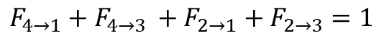
Enclosure 1
All view factors from 2 and 4 sum to 1
2 Detector
(CF @ 160 K)
1 Window
Black Body
e = 1
T = 300K
4 Shield Face
3 Cryostat Wall
T = 300 K
e = 0.05
$$F_{4→1}+F_{4→3 }+F_{2→1}+F_{2→3}=1$$

Slide 7
Enclosure 2 and 3
F₅₆ = 1
F₇₅ = 1
5 Detector Shield Rear
Enclosure 2
7 Detector Rear
Enclosure 3
2 Detector
4 Detector shield front
6 Cryostat Rear

Slide 8
Analytical Model
View factors in enclosure 1 sum to 1
Detector modelled as disk concentric with cryostat
Circular detector with area equal to square detector (D = 117mm)
Shield and detector assumed perfectly coplanar (F₂₄ = 0)
Shield perfectly floating (heat in = heat out)

Slide 9
Analytical Model - Results
Heat flux to detector face | Q2 | 3.87 W
Shield temp | T4 | 256 K
Heat flux to shield (from encl 1) | Q4 | 0.32 W

Slide 10
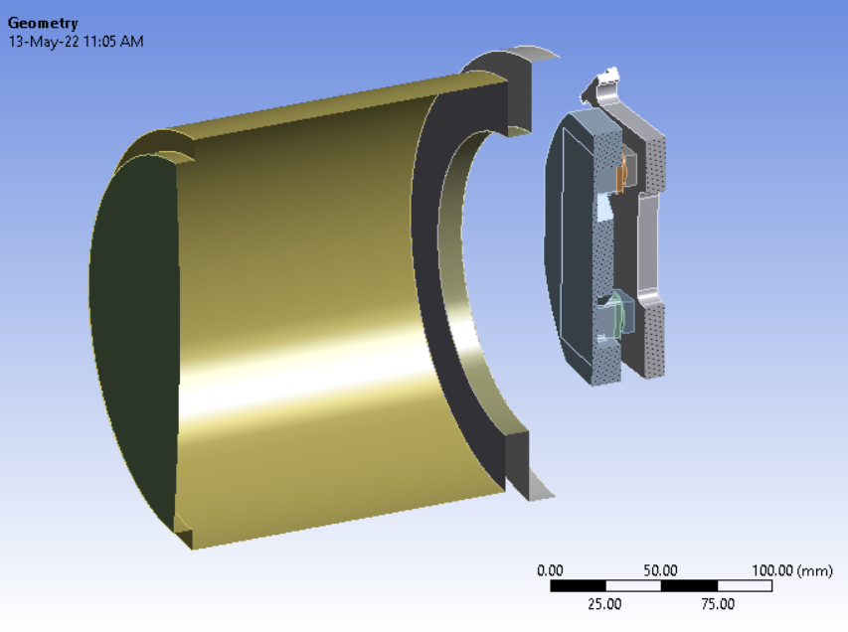
ANSYS Model - setup
Surface-surface radiation between cryostat, window, detector
Open enclosure, ambient temp = 256 K (shield temp)
Walls and window use shells
Detector uses volume elements
Detector shield not modelled
Small features and holes removed

Slide 11
Boundary Conditions
Walls & window: 300K
Window emissivity: 1
Cryostat: 0.05 (shiny, polished)
Detector shield
Modelled as “to ambient” radiation boundary @ 256 K
Detector and backplane
Detector emissivity 1 (blackened)
150 K cold strap applied
G10 mounts ignored (perfect insulators)

Slide 12
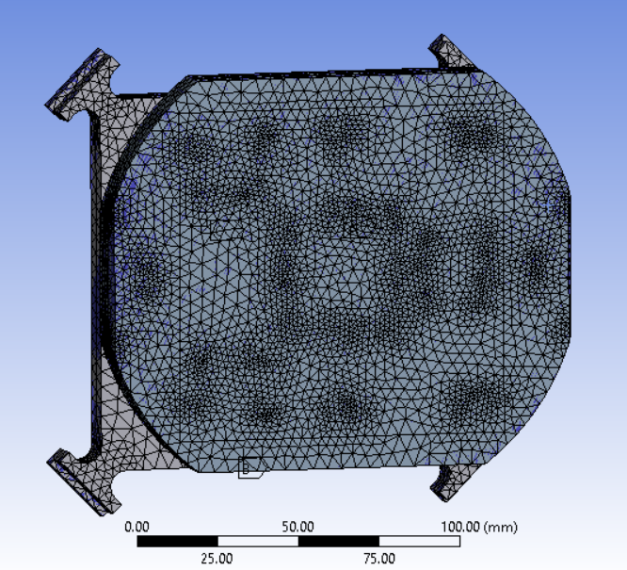
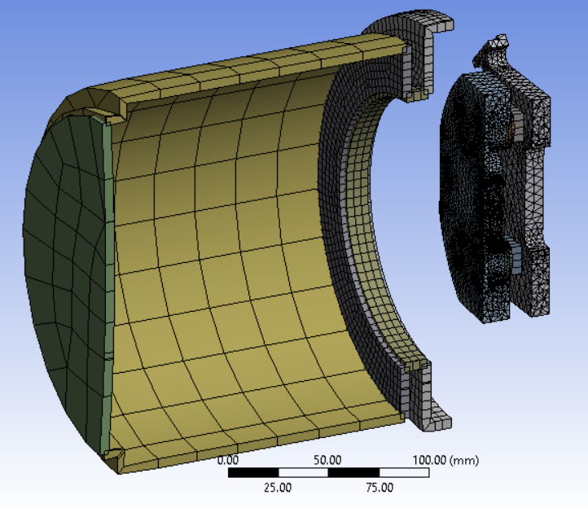
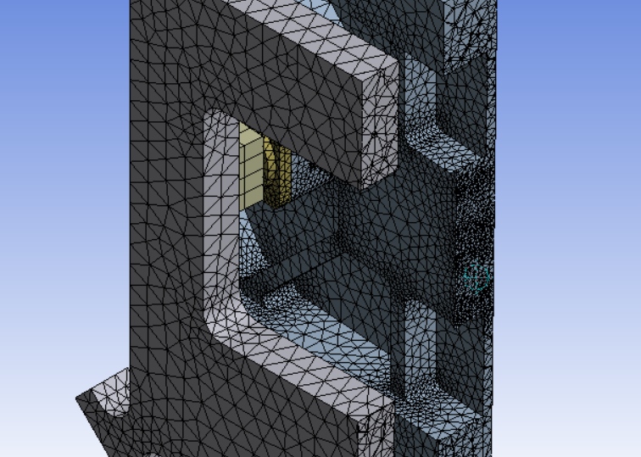
Mesh

Slide 13
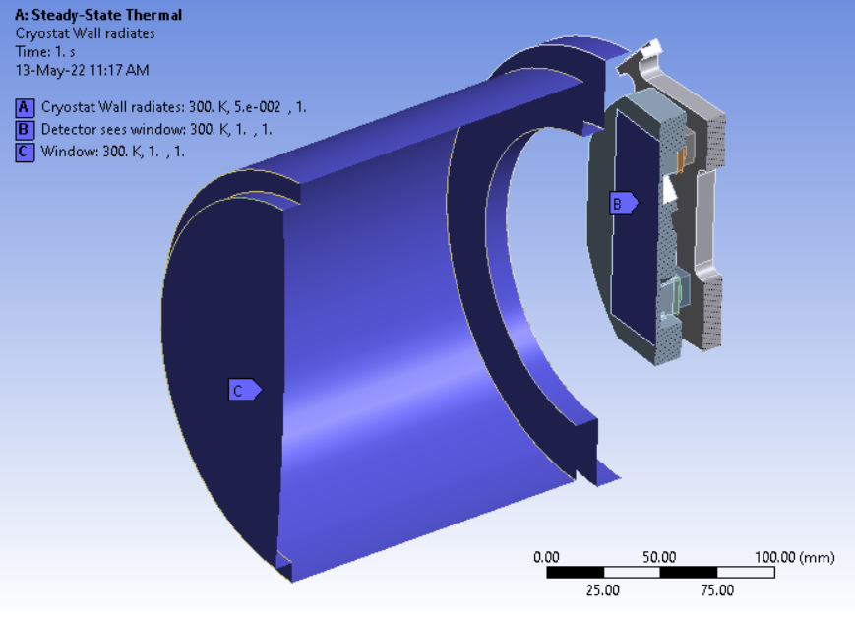
Surface-Surface Radiation
Enclosure type: open
Ambient temp: 256 K (temp of passive shield)
Emissivities:
Window: 1
Cryostat wall: 0.05
Detector: 1

Slide 14
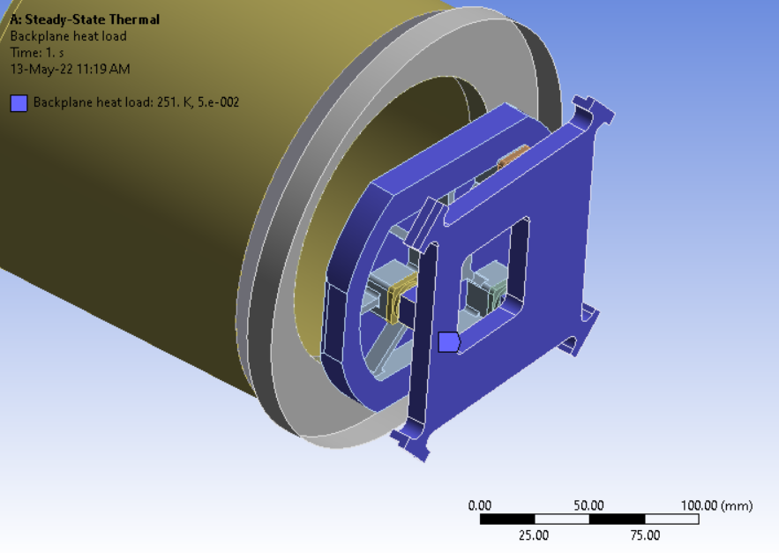
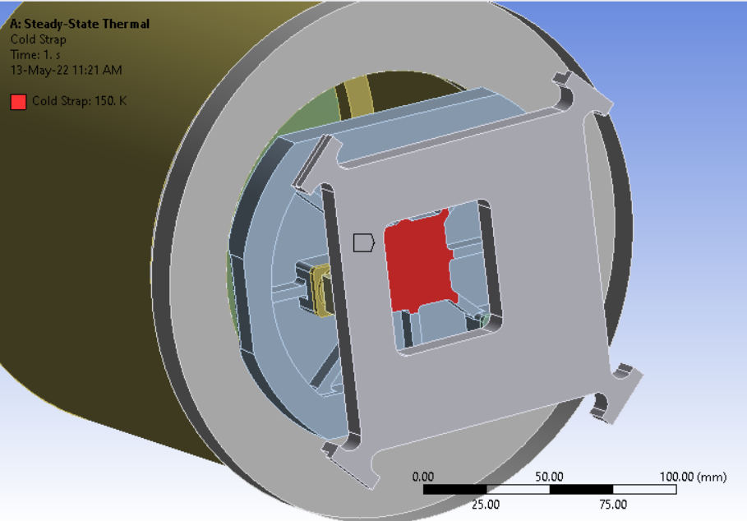
Loads on detector
Radiation load to detector shield
E = 0.05, T = 256 K
No radiation forward from backplane (occluded)
Cold strap: temp constraint @ 150 K

Slide 15
Heat fluxes
Ambient temp set @ 300 K to validate analytical model
Set to 254 K for more accurate temp
 | Symbol | Analytical | ANSYS (ambient 300) | ANSYS (ambient 254)
Heat landing on detector face | Q2 | 3.95 | 3.87 | 3.87
Detector max temp | T2 | 150 | 162 | 162

Slide 16
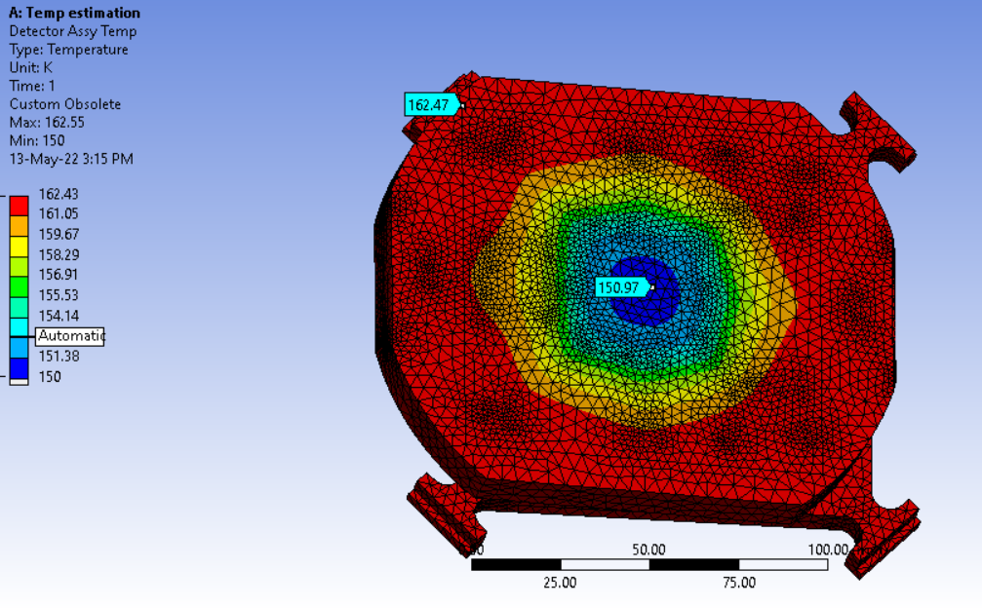
Detector temps

Slide 17
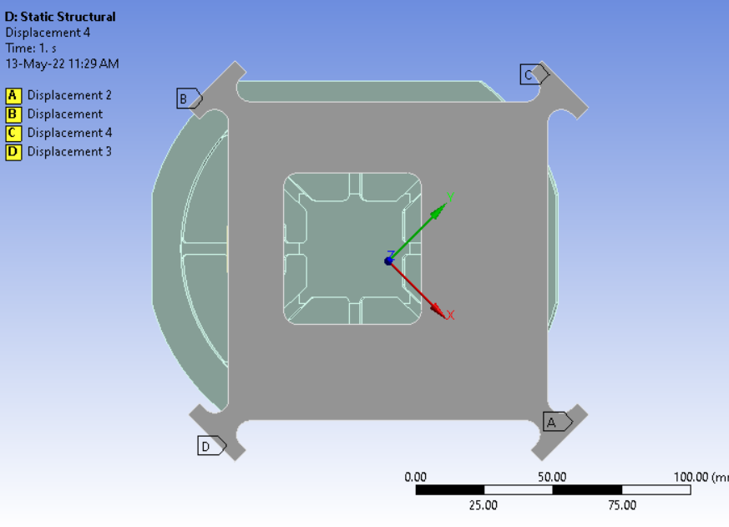
Mechanical movement
Support constraints:
Free to move radially per G10 flexures

Slide 18
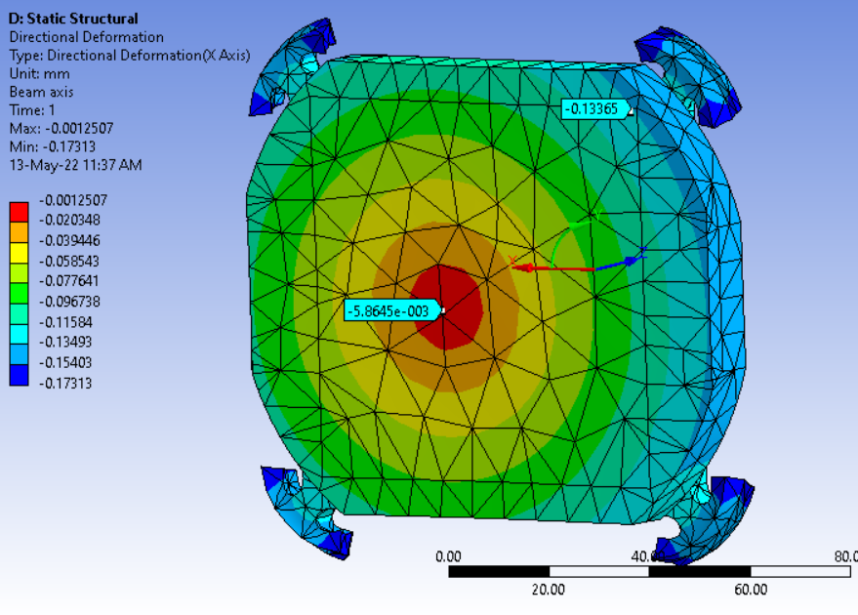
Radial Movement
Max: 0.13 mm

Slide 19
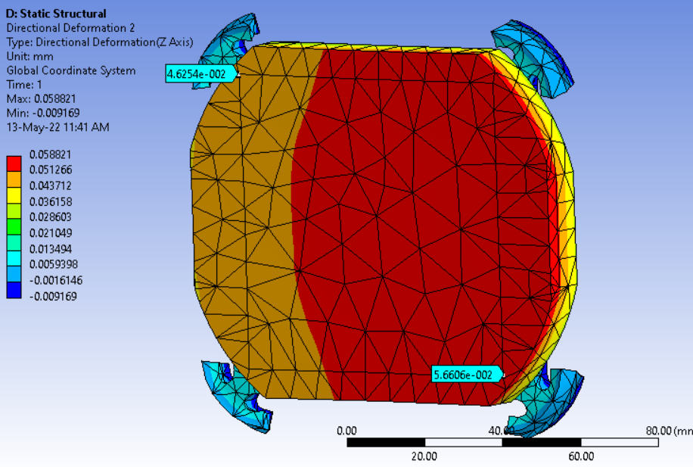
Axial movement
Deviation across face 10 um
Most appears to be rigid-body movement

Slide 20
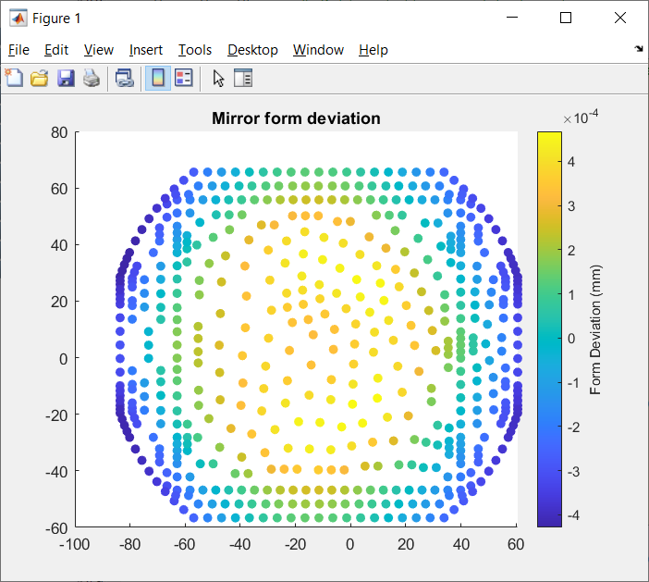
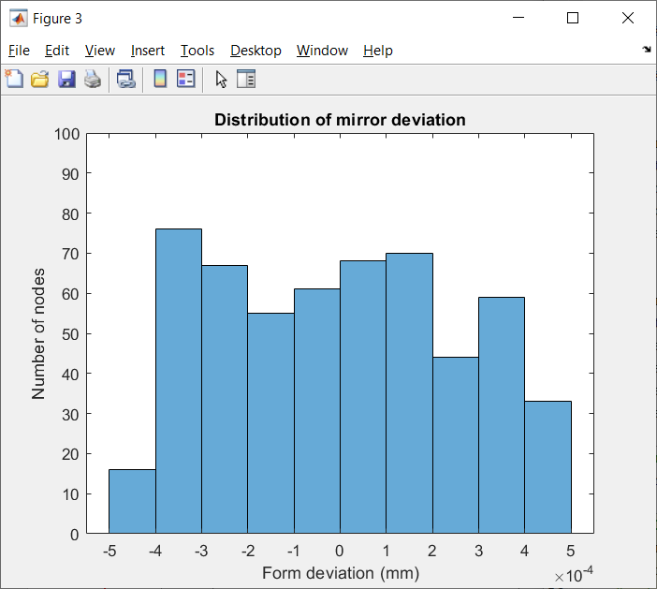
Deviation from flatness
Get deviation from flat by subtracting out rigid-body motion
Range of deviation: +467/-428 nm

Slide 21
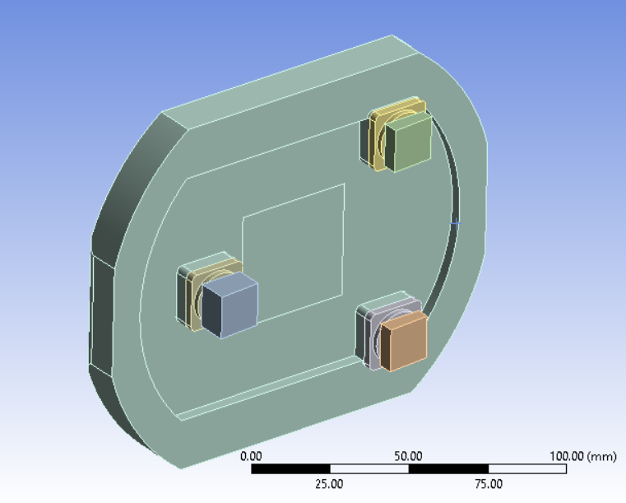
Case 2: Remove ribs
Ribs removed by filling in pockets

Slide 22
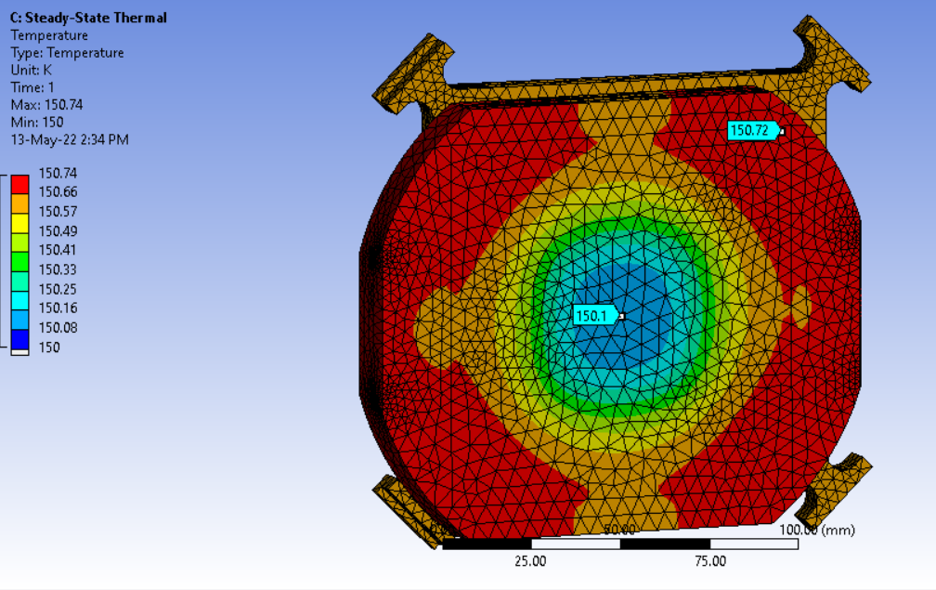
Temps with ribs removed
150.7 K max temp

Slide 23
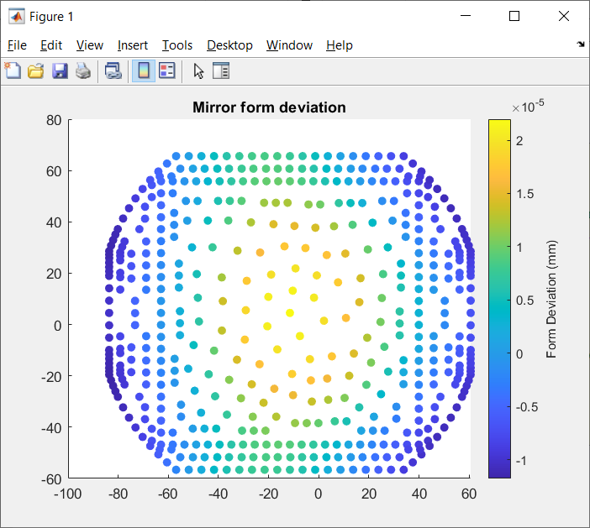
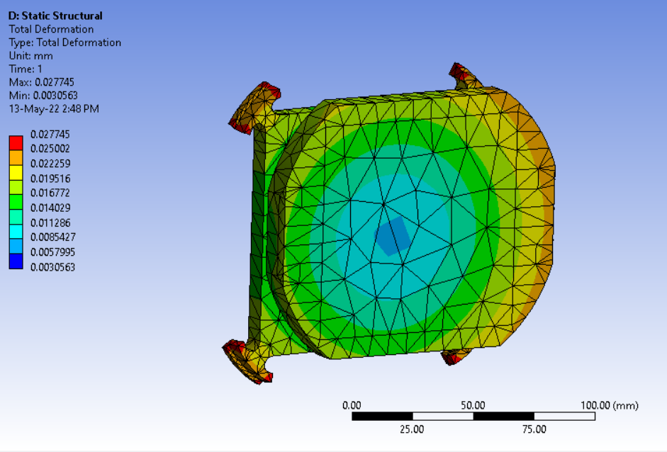
Displacement without ribs
Flatness deviation: +22/-11 nm

Slide 24
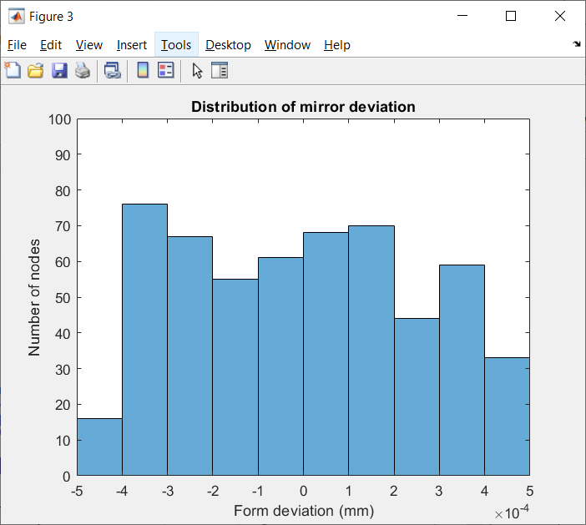
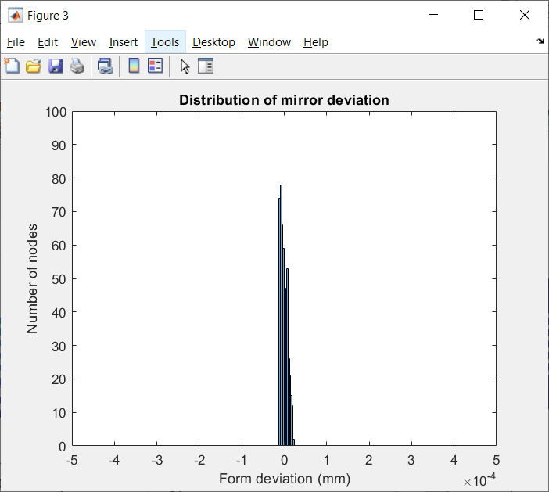
Comparison of flatness change
With ribs
Ribs removed

Slide 25
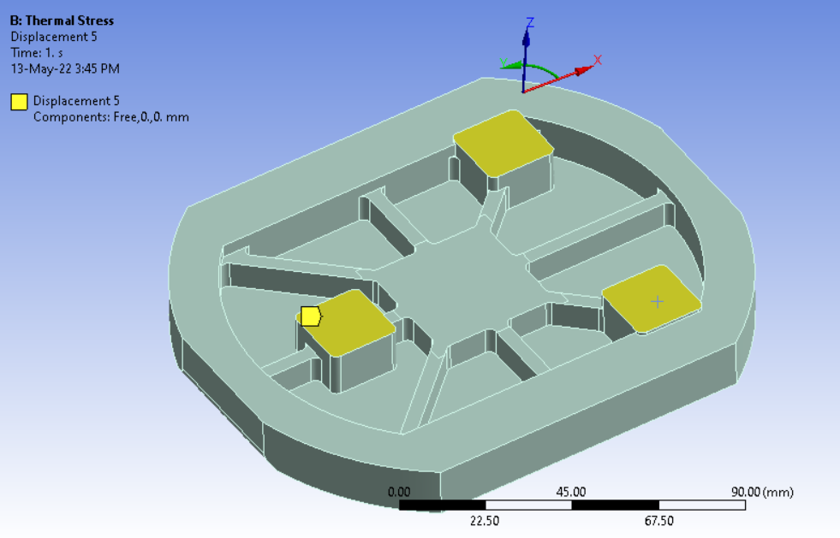
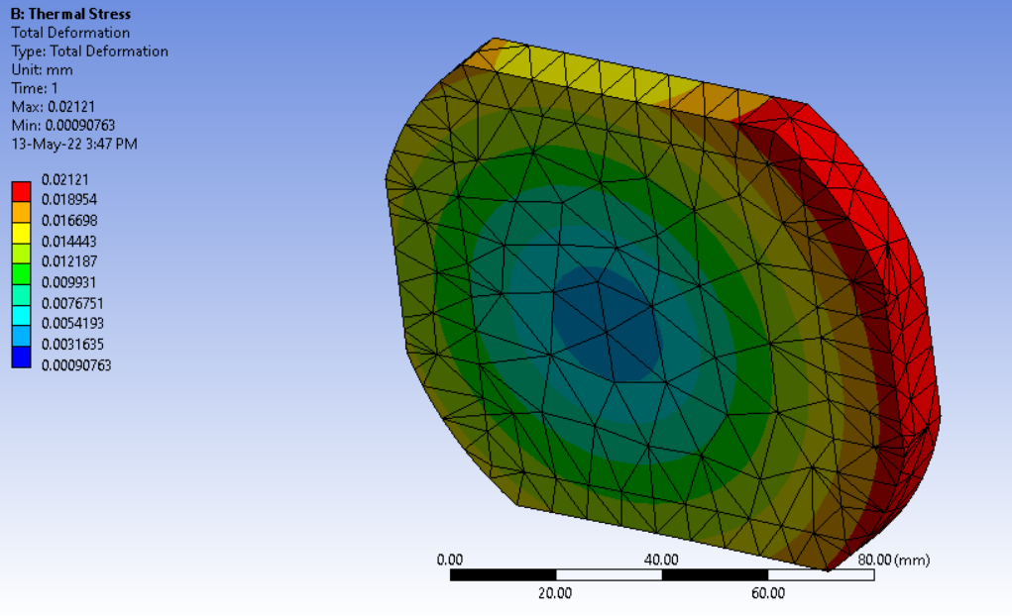
Flatness with ideal flexure mount
Temperature gradients kept from before
Ignore back plane
Constraint:
Cylindrical CS, axial and tangential locked. Free in radial
Simulates 3 ideal blade flexures

Slide 26
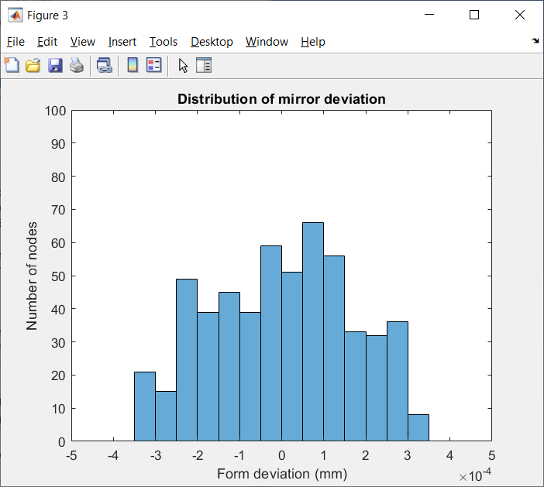
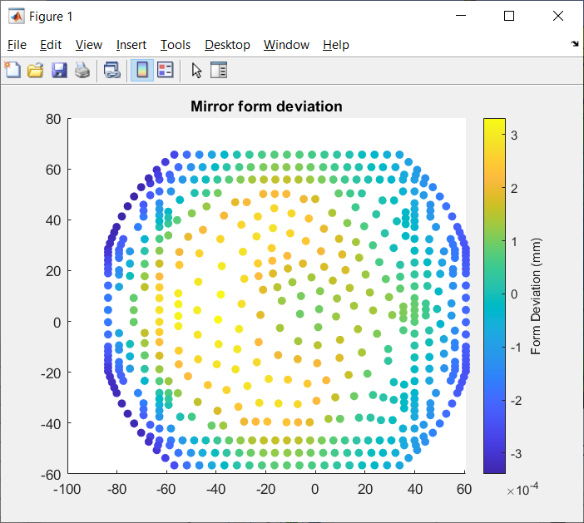
Flatness with ideal flexure mounts
Deviation: +331/-339 nm

Slide 27
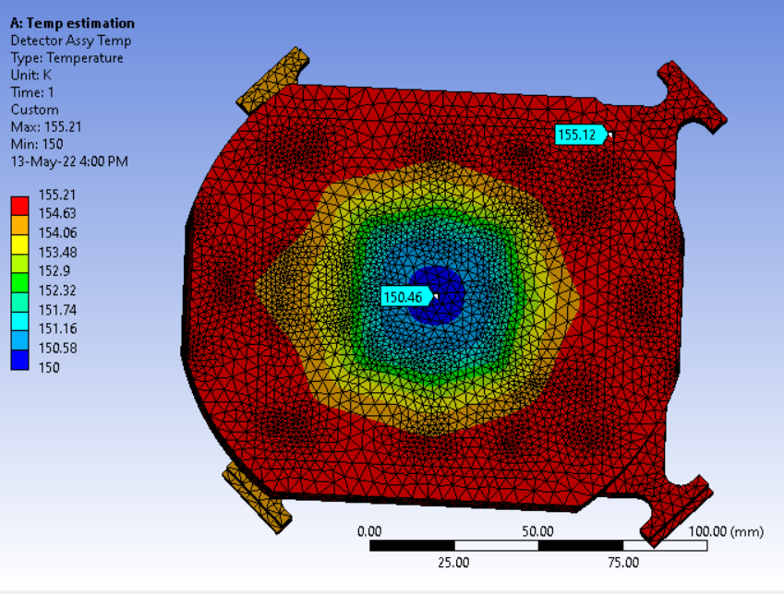
Better active shielding
Simulated by:
Set cryostat walls to 160K
Set “to ambient” to 160 K
Analytical: heat flux to detector = 0.41 W
Ribs and mount kept from original
Qdet = 1.9 W
Analytical: 2.8 W
Extra cold shield view factor likely the cause

Slide 28
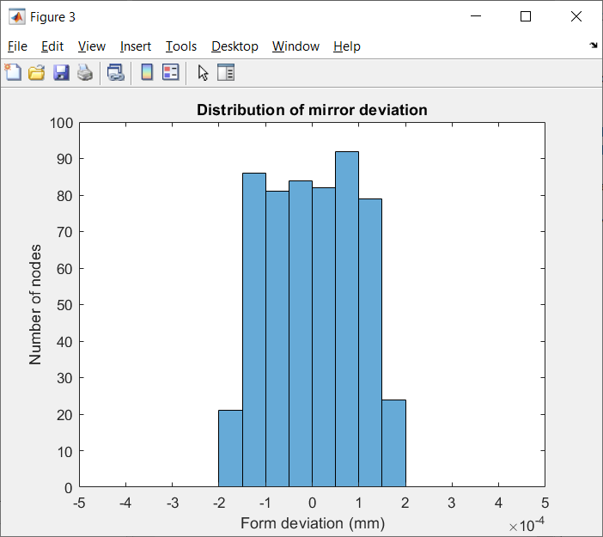
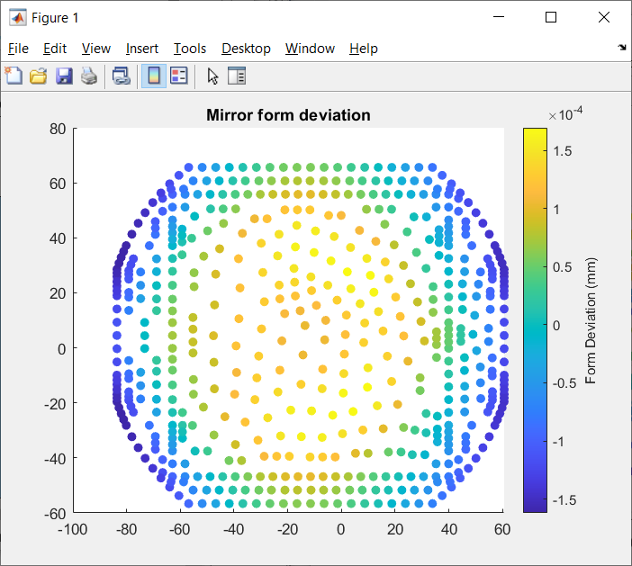
Better shielding effect on flatness
Deviation: +169/-162 nm

Slide 29
Summary
Option | Min/Max face temp (K) | Max/min form deviation (nm)
Baseline – as designed | 151/162 | +467/-428
Remove ribs | 150.1 / 150.7 | +22/-11
Make ideal flexure mount (keep ribs) | 151/162 | +331/-339
Ideal active shielding (keep ribs) | 150.46 / 155.12 | +169/-162
Ribs removed and ideal shielding | 150.06 / 150.39 | 11.3/-6.7

Slide 30
Conclusions
Removing ribs gives factor of 10 improvement in shape tolerance
XY motion is dominated by absolute temperature. Z-axis is more what we see
Add active shield that covers all hot cryostat walls. Gives factor of 2.7 improvement for very little cost
Improving mount overconstraint has some effect, but minimal
In-plane movement of detector dominated by CTE. Almost all results show -21 um movement at edge
Normal-to-beam movement will be Z-axis movement sin detector tilt angle

Slide 31
Sensitivity to parameter changes
Question: how much should be concerned with maintaining strap temp, shield temp, detector current?
Method: bump parameters from equilibrium slightly, solve for image movement per unit change

Slide 32
Parameters to be changed
Strap temp (simulates cooling power change)
Shield temp (varying +/- by 5K)
Heat load in detector face (3 W default, changed to 3.1 W)

Slide 33
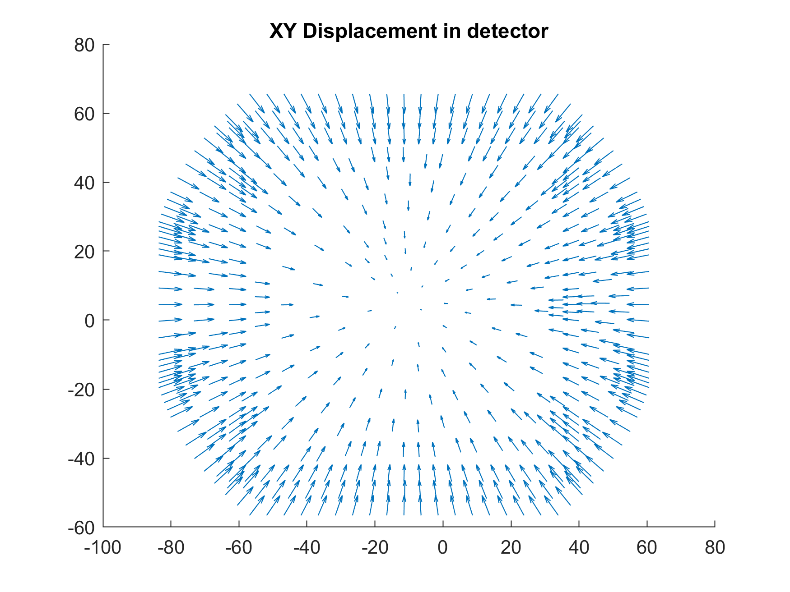
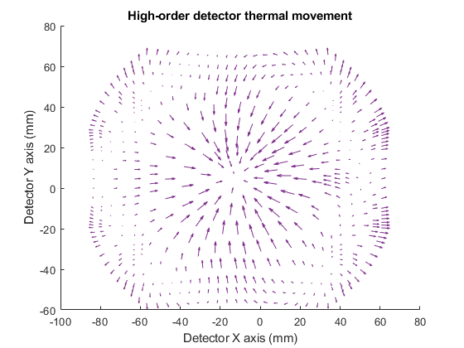
Uncorrectable XY movement
Subtract rigid-body movement and bulk thermal contraction
Represents movement not calibratable with single temp sensor
Residuals
Linear regression
Subtract:
-Rigid Body Movement
-Uniform contraction

Slide 34
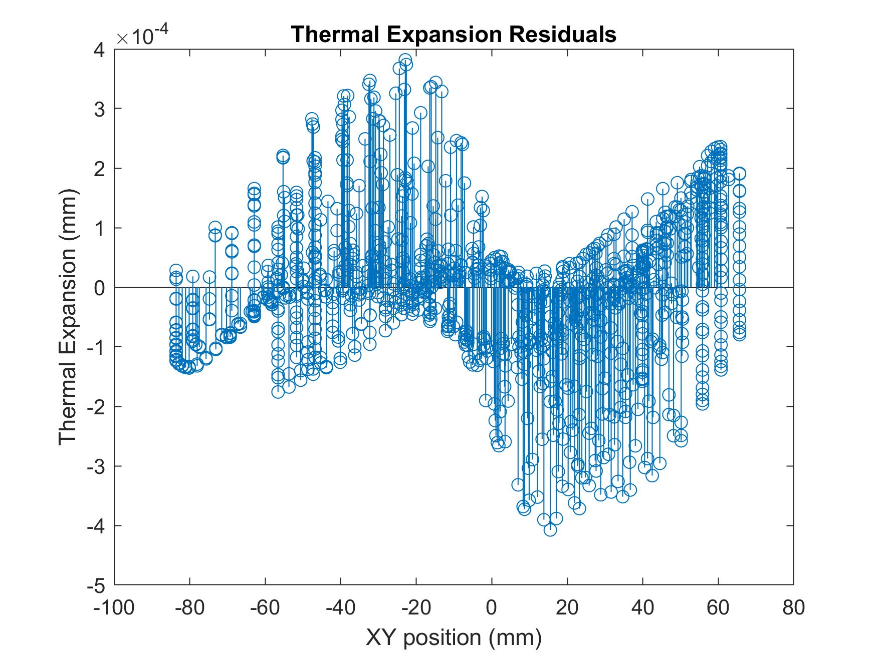
Uncorrectable XY movement
Single value for comparison
Use RMS of residuals

Slide 35
Equibrium values
 | With ribs | Without ribs
Detector temp range (K) | 16.03464508 | 6.71352386
Max radial displacement (mm) | -0.01898411 | -0.02051212
RMS uncorrectable XY error (mm) | 0.00423649 | 0.00000472
Detector Flatness (mm) | 0.00065056 | 0.00027275

Slide 36
Sensitivity Values
XY RMSE per unit change
Sensitivity to | Unit | With Ribs | Without Ribs
Detector Power | mm/W | 5.92E-05 | 3.02E-05
Strap Temperature | mm/K | -1.43E-05 | -2.52E-06
Shield Temp | mm/K | 3.17E-06 | 2.15E-06

